Slide 1

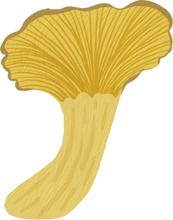

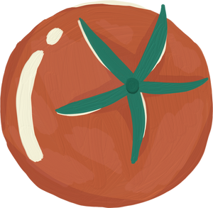
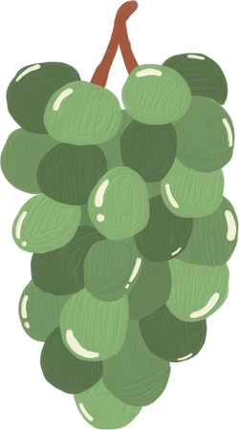
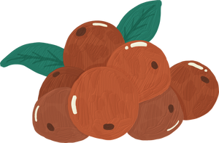
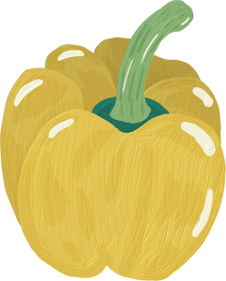
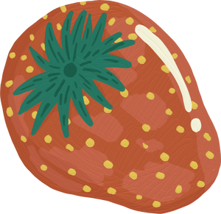
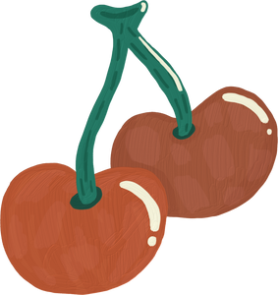
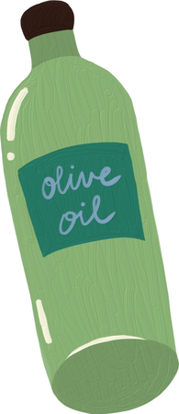
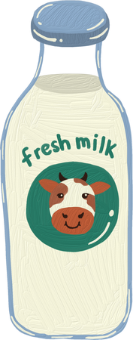
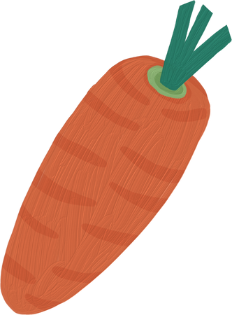
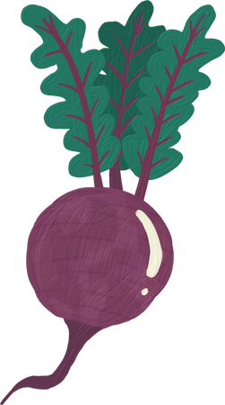

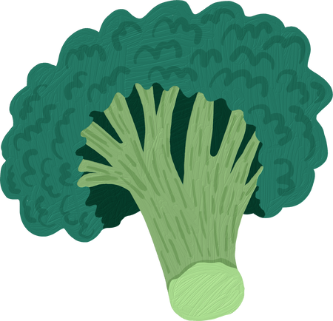
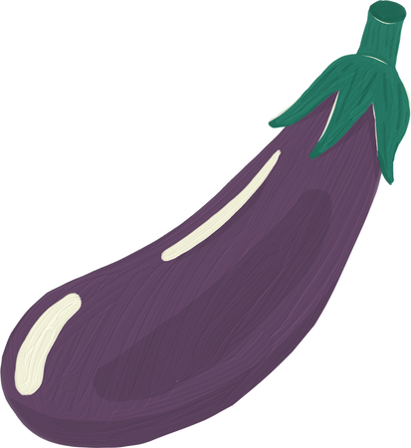
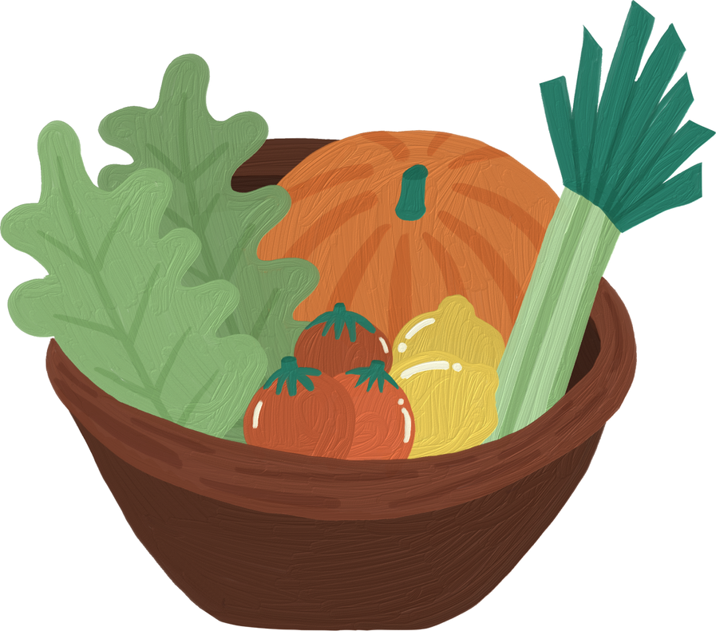
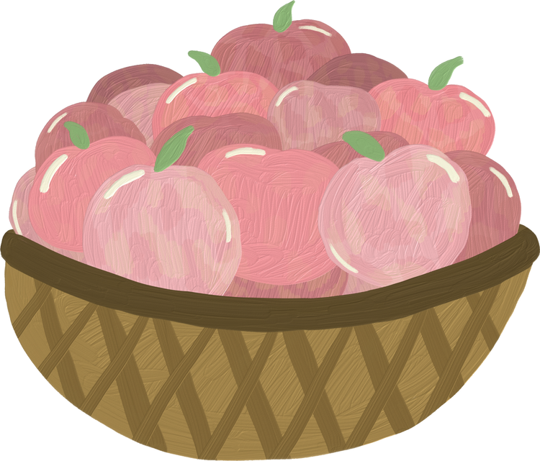
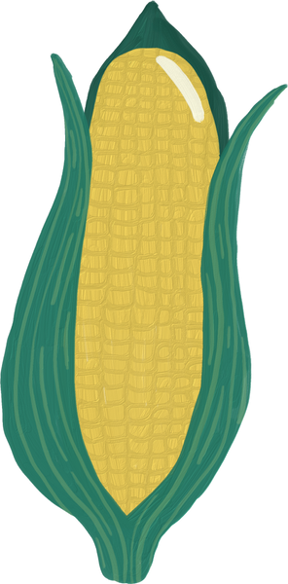
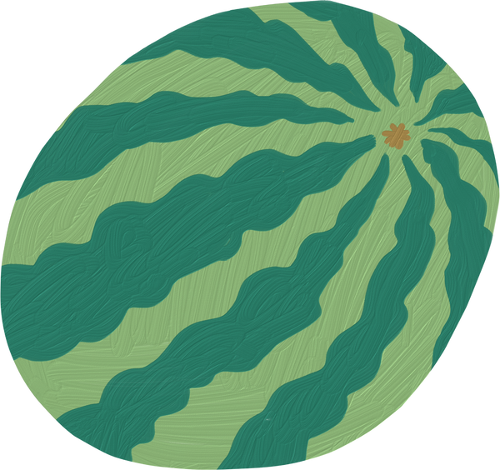
VEGETABLE
CLASSIFICATION
Presentation by Choy Jee Hung Caleb p2341475

Slide 2
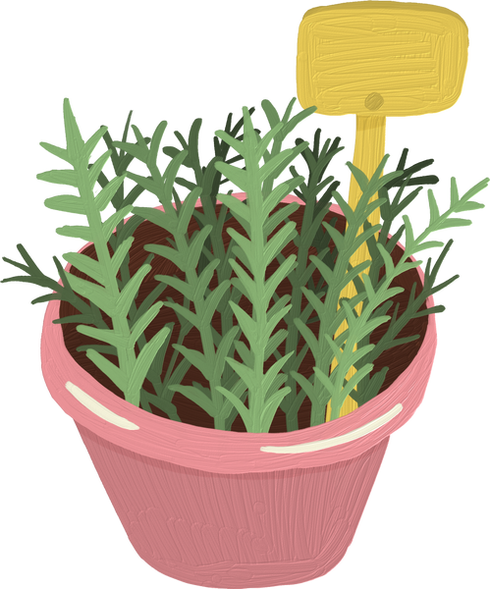
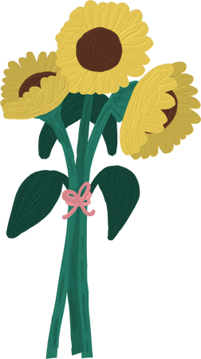
TABLE OF CONTENT
1
2
3
Data Exploration
Data Preprocessing
Model building
4
5
6
Model Improvements
Model Evaluation
Conclusion

Slide 3
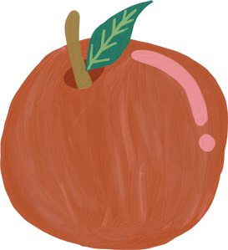
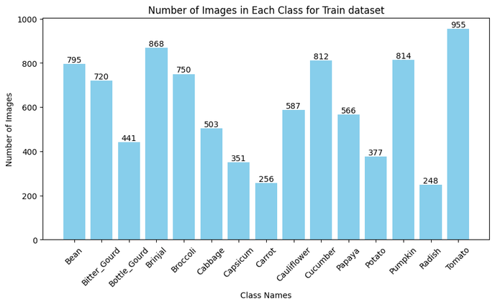
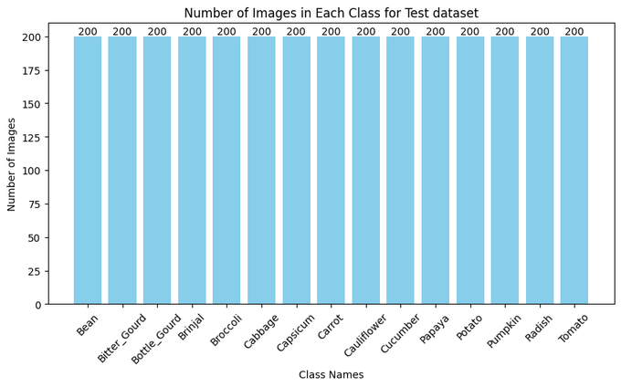
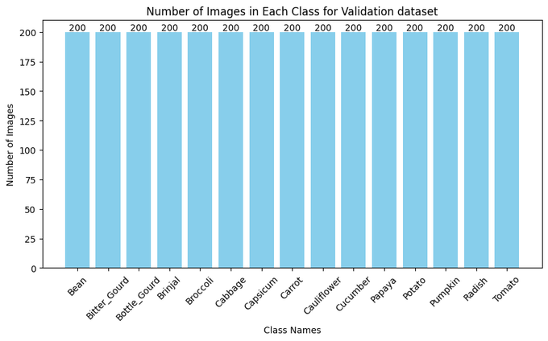
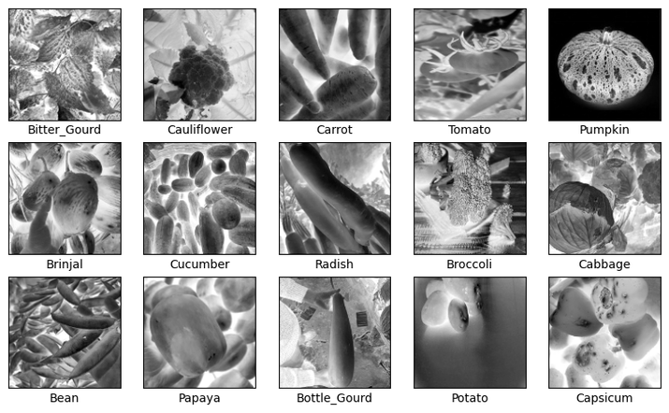
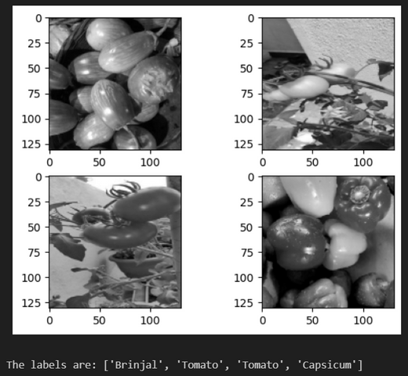
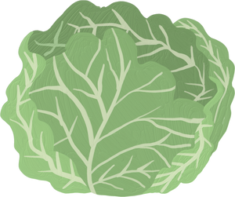
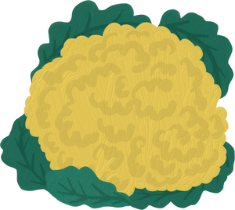
Data Exploration

Slide 4
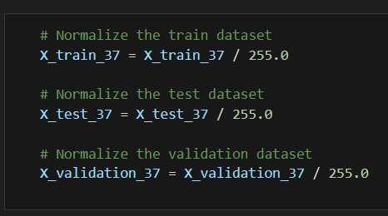
PreProcessing - Normalization
Stabilizing Training:
Helps in stabilizing and accelerating the training process.
Mitigates the problem of vanishing or exploding gradients during backpropagation by ensuring that inputs to each layer remain within a similar range.
Generalization:
Aids in generalizing the model's learning. By reducing the change in the distribution of network activations due to parameter updates) ensures that the network learns features that are applicable across different samples in the dataset, rather than being overly tailored to the training data.

Slide 5
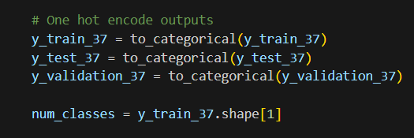
PreProcessing - OneHotEncoding
One-hot encoding is typically used for categorical variables, where the output needs to represent discrete classes.
Representation of Categorical Data:
Represent categorical variables numerically. In classification tasks, the output usually corresponds to different classes or categories.
Compatibility with Neural Networks:
Neural networks, including CNNs, operate on numerical data. One-hot encoding converts categorical labels into a format that neural networks can process. This enables CNN models to effectively learn relationships and patterns in categorical data through the optimization of numerical parameters during training.

Slide 6
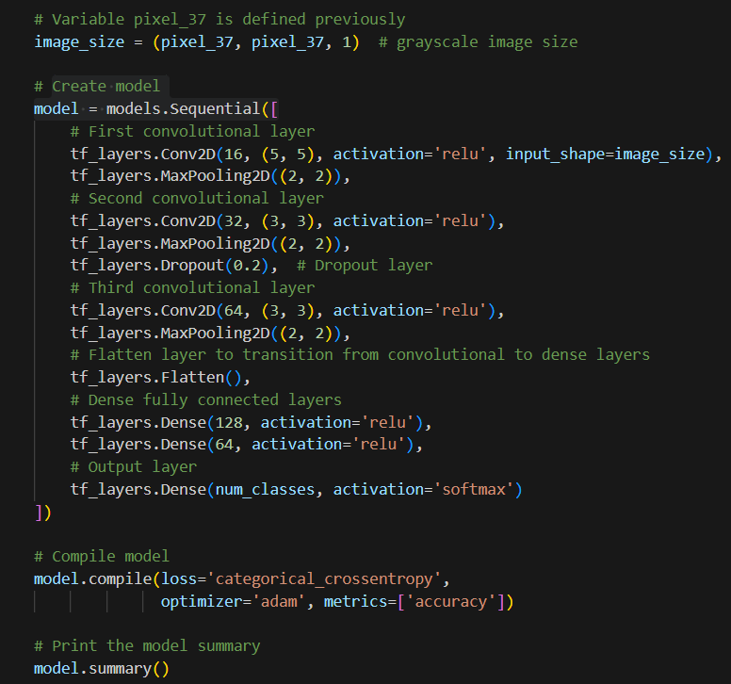
Model Building - Initial 37x37
Input Layer:
Input Shape: (pixel_37, pixel_37, 1)
First Convolutional Layer:
Conv2D Layer:
Filters: 16
Kernel Size: (5, 5)
Activation: ReLU
MaxPooling2D Layer:
Pool Size: (2, 2)
Second Convolutional Layer:
Conv2D Layer:
Filters: 32
Kernel Size: (3, 3)
Activation: ReLU
MaxPooling2D Layer:
Pool Size: (2, 2)
Dropout Layer:
Dropout Rate: 0.2
Third Convolutional Layer:
Conv2D Layer:
Filters: 64
Kernel Size: (3, 3)
Activation: ReLU
MaxPooling2D Layer:
Pool Size: (2, 2)
Flatten Layer:
Transforms the 3D output of the convolutional layers into a 1D vector.
First Dense Layer:
Units: 128
Activation: ReLU
Second Dense Layer:
Units: 64
Activation: ReLU
Output Layer:
Units: num_classes (number of classes for classification)
Activation: Softmax
Model Compilation:
Loss Function: Categorical Crossentropy
Optimizer: Adam
Metrics: Accuracy

Slide 7
Model Building - Initial 37x37
Conv2D layer: A convolutional layer that applies a number of convolution filters to the input data to extract spatial features.
Activation (ReLU): A function that applies the rectified linear unit activation (ReLU(x) = max(0, x)), introducing non-linearity to the model.
MaxPooling2D: A downsampling layer that reduces the spatial dimensions (height and width) of the input by taking the maximum value over a defined window, effectively reducing the amount of computation in the network and controlling overfitting.
Dropout: A regularization layer that randomly sets a fraction of input units to zero at each update during training time, which helps prevent overfitting by ensuring that the network does not rely too much on any individual node.
Flatten: A layer that converts a multidimensional tensor into a one-dimensional vector. This transition is necessary to connect convolutional layers with dense (fully connected) layers.
Dense: A fully connected layer where each input is connected to each output by a learnable weight. It allows the network to learn complex representations by combining features learned in previous layers.
Output: The final layer of the network that produces the classification output. Each neuron corresponds to a class, and the softmax function ensures that the output can be interpreted as probabilities.
Loss Function (Categorical Crossentropy): A loss function used for multi-class classification problems. It measures the difference between the true class labels and the predicted class probabilities, encouraging the model to output probabilities close to the true labels.
Optimizer (Adam): An optimization algorithm that computes adaptive learning rates for each parameter. It combines the advantages of two other popular optimization techniques: AdaGrad and RMSProp.
Metrics (Accuracy): A metric that calculates the proportion of correct predictions. It is a straightforward measure of how often the model's predictions match the true labels.

Slide 8
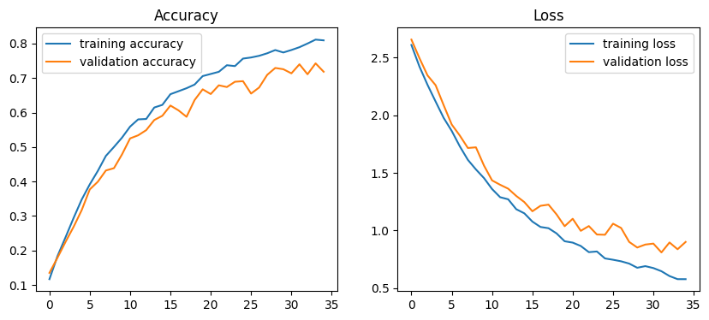
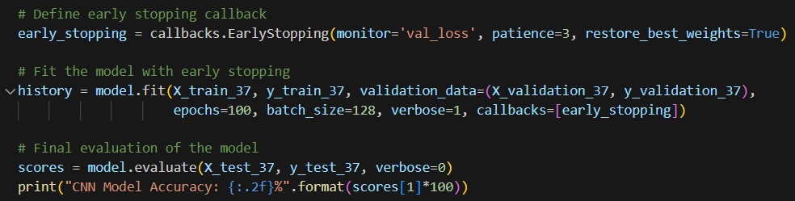
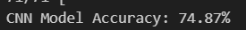
Evaluation - Initial 37x37
The initial model has a accuracy of 74.87%.
There is some overfitting as seen in the gap between training and validation accuracy.
There is room for improvements regarding the model accuracy and overfitting.

Slide 9
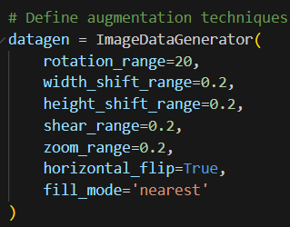
Data Augmentation 37x37
Rotation Range:
By specifying a rotation range, you allow the training images to be rotated by a random angle within the specified range. This helps the model become invariant to rotation variations, making it more robust to images that are captured from different angles or orientations.
Width Shift Range and Height Shift Range:
These parameters allow for horizontal and vertical shifting of the images within a specified range. This can simulate variations in object position within the image, helping the model learn to recognize objects regardless of their location within the image.
Shear Range:
Shearing involves shifting one part of the image in a fixed direction, creating a "shear" effect. By applying random shearing to the training images, you introduce distortions that can help the model learn to recognize objects from different perspectives.
Zoom Range:
Zooming involves either zooming in or out of the image. By applying random zooming to the training images, you simulate variations in scale, which helps the model become invariant to changes in object size within the image.
Horizontal Flip:
This parameter allows for randomly flipping the images horizontally. Horizontal flipping can help the model become invariant to left-right orientation variations, which is particularly useful for tasks where the orientation of objects is not significant.
Fill Mode:
This parameter determines the strategy used to fill in newly created pixels that may be introduced during augmentation, such as when performing rotations or shifts. 'Nearest' mode fills new pixels with the nearest pixel value from the original image, which helps maintain the overall appearance of the image.

Slide 10
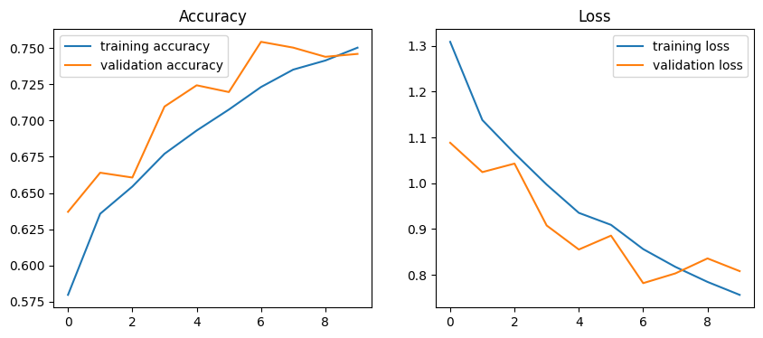
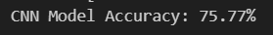
Evaluation - Data augmented 37x37
The untuned model has a accuracy of 75.77% with the data augmented dataset.
Overfitting has been reduced significantly.
There is room for improvements regarding the model accuracy which we would solve through tuning of the parameters.

Slide 11
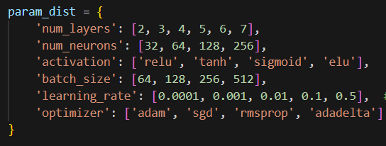
Model Improvements- Parameter tuning
I used RandomSearch as it is explore a wider variety of hyperparameter values in fewer trials. This often leads to finding better hyperparameter configurations with less computational cost and can more effectively explore regions of the hyperparameter space that might contain optimal or near-optimal values
'num_layers': The number of layers in a neural network determines its depth. Models more complex functions and learn more abstract data.
'num_neurons': More neurons can capture more details and affects the capacity of the network to learn patterns from the data
'activation': Allow to learn and model complex data by introducing non-linearities
'batch_size': Smaller batch sizes lead to more frequent updates and can help escape local minima. Larger batch sizes provide more stable updates but require more memory and might take longer per epoch.
'learning_rate': A higher learning rate can speed up training but may cause the model to converge too quickly to a suboptimal solution. A lower learning rate provides more precise updates but can slow down training and risk getting stuck in local minima.
'optimizer': Different optimizers have different strategies for adjusting the learning rate and handling gradients, which can influence how quickly and effectively the model converges.

Slide 12
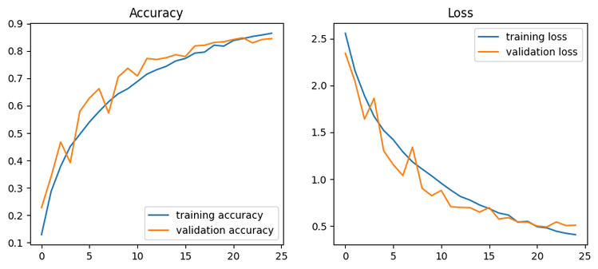
Evaluation - Comparing improvments
The CNN Model Accuracy has improved from 74.87% in the initial model to a 85.53% after all data augmentation and parameter tuning.
Overfitting has been reduced significantly in the final model compared with the initial model.
The best parameters in this case would be as shown:

Slide 13
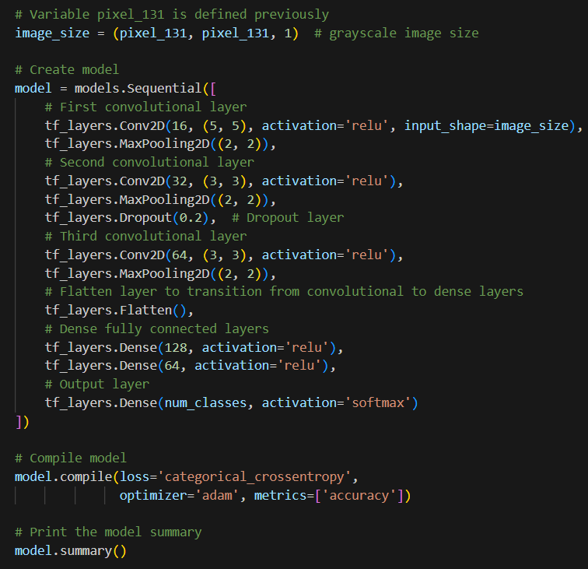
Model Building - Initial 131x131
The base model is the same as the 37x37 model to ensure consistency when comparing accuracies and loss.

Slide 14
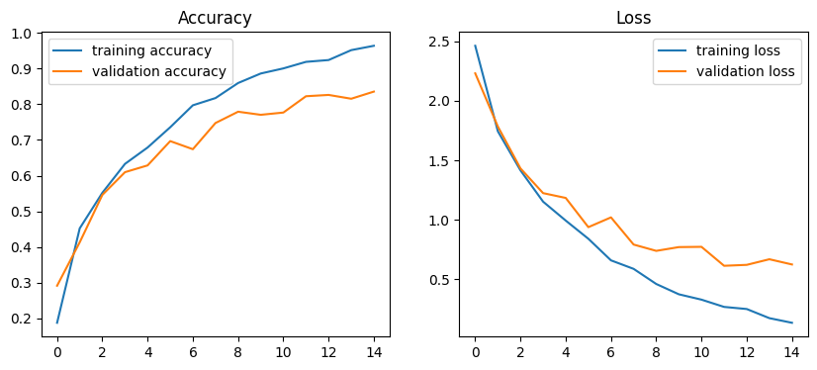
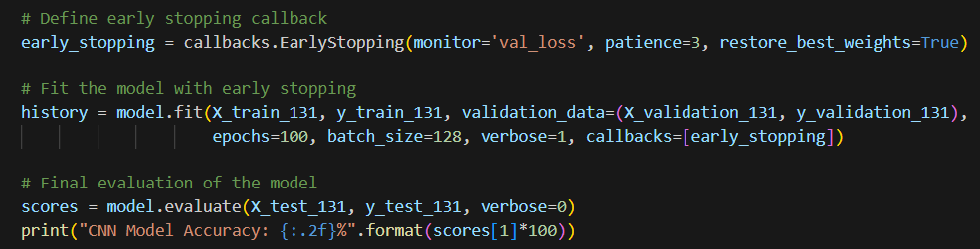
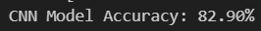
Evaluation - Initial 131x131
The initial model has a accuracy of 82.90%.
There is some overfitting as seen in the gap between training and validation accuracy.
There is room for improvements regarding the model accuracy and overfitting.

Slide 15
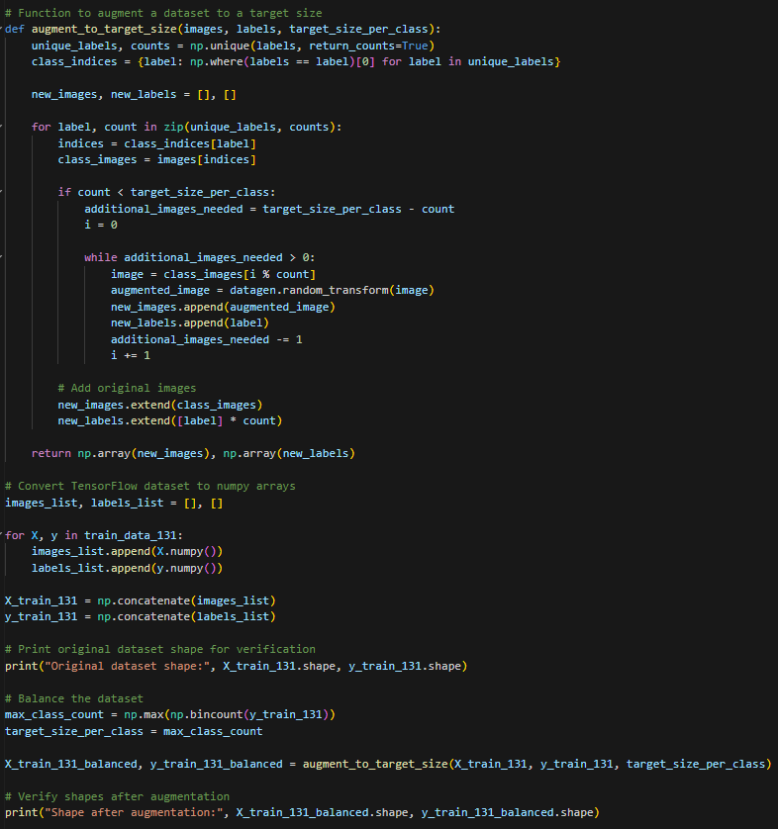
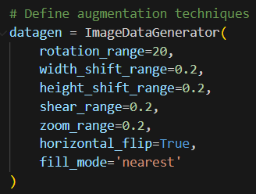
Data Augmentation 131x131
The data augmentation steps are the same as model 37x37 to ensure consistency when comparing accuracy and loss.
For both 37x37 and 131x131 data augmentation, I made the number of images within each class the same to ensure that the machine learning will have lesser bias when training as they might be too familiar on one particular type of vegetable.

Slide 16
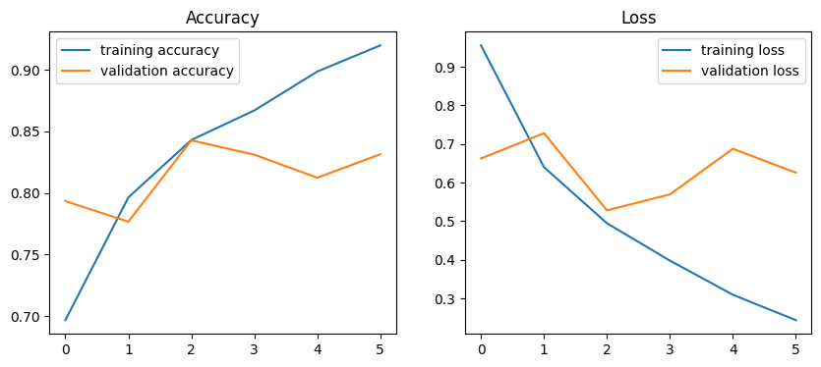
Evaluation - Data augmented 131x131
The untuned model has a accuracy of 85.03% with the data augmented dataset.
Overfitting has been increased significantly.
We still be using the augmentated dataset for hyperparameter tuning as hyperparameter tuning is also a way to further reduce overfitting within the model. If it does not improve overfitting for the hyperparameter tuned model, we would revert back to the unaugmented dataset for tuning.
There is room for improvements regarding the model accuracy which we would solve through tuning of the parameters.

Slide 17
Model Improvements- Parameter tuning
I used RandomSearch as it is explore a wider variety of hyperparameter values in fewer trials. This often leads to finding better hyperparameter configurations with less computational cost and can more effectively explore regions of the hyperparameter space that might contain optimal or near-optimal values
I used random search on the same parameters that we have used in the previous model.

Slide 18
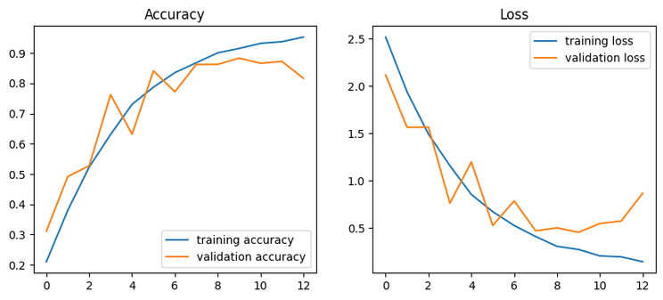
Evaluation - Comparing improvments
The CNN Model Accuracy has improved from 82.90% in the initial model to a 88.33% after all data augmentation and parameter tuning.
Overfitting has been reduced in the final model compared with the initial model as seen by the smaller gap.
The best parameters in this case would be as shown:

Slide 19
Conclusion
The final CNN Model Accuracy for pixel size 37x37 model is 85.53%.
The final CNN Model Accuracy for pixel size 131x131 model is 88.33%.
With smaller input sizes like 37x37 pixels, the CNN might struggle to capture intricate details and features in the images and find it challenging to distinguish between similar classes or categories accurately, leading to the classification accuracy being lower compared to larger input sizes.
Larger input sizes like 131x131 pixels provide more spatial information to the CNN and has a better chance of capturing fine details and features present in the images, which can improve its ability to discriminate between classes accurately.With more information available in each image, the network may generalize better to unseen data, leading to a higher classification accuracy.
However, it may also lead to more overfitting as it memorizes the training data rather than learning meaningful features, especially if the dataset is complex.

Slide 20

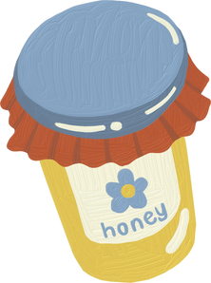
THE END
THANK YOU FOR LISTENING

